Slide 1
DDS Analytics Predictive Model
Presenter: Patricia Attah

Slide 2
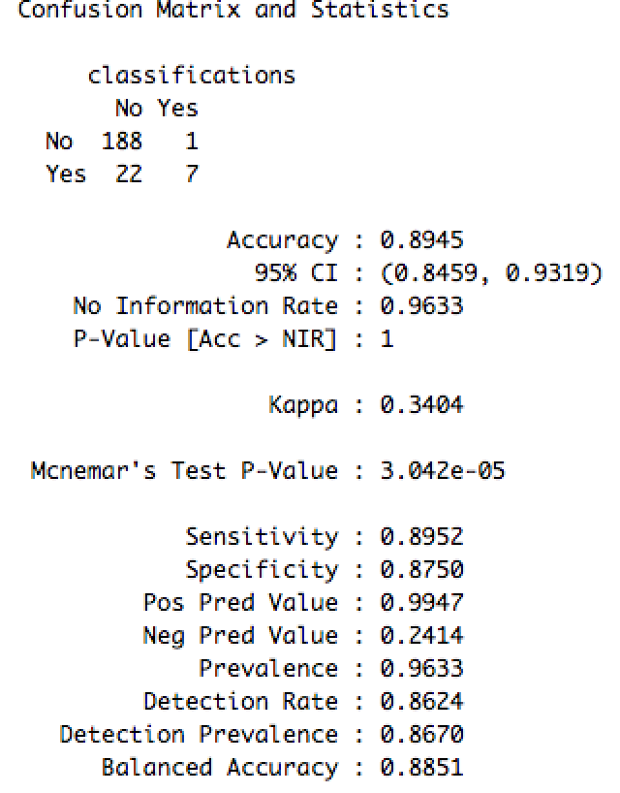
Attrition Prediction Using KNN Classifier
Knn classifier was used to analyze this data.
This is a look into the factors causing Attrition
Variables:
Total Working Years,
Job Involvement
Over Time
Results of Predictive model
Sensitivity of 0.8952
Specificity of 0.8750.

Slide 3
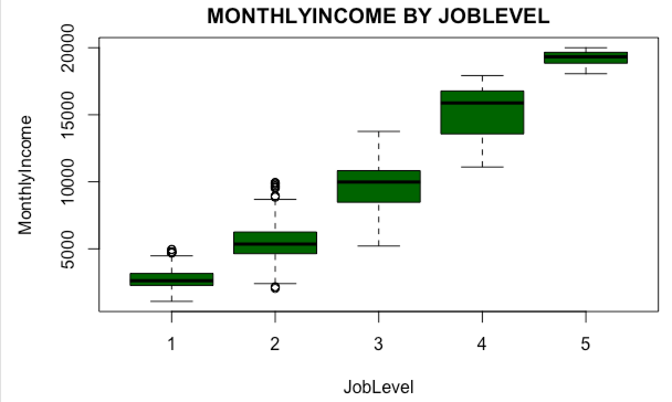
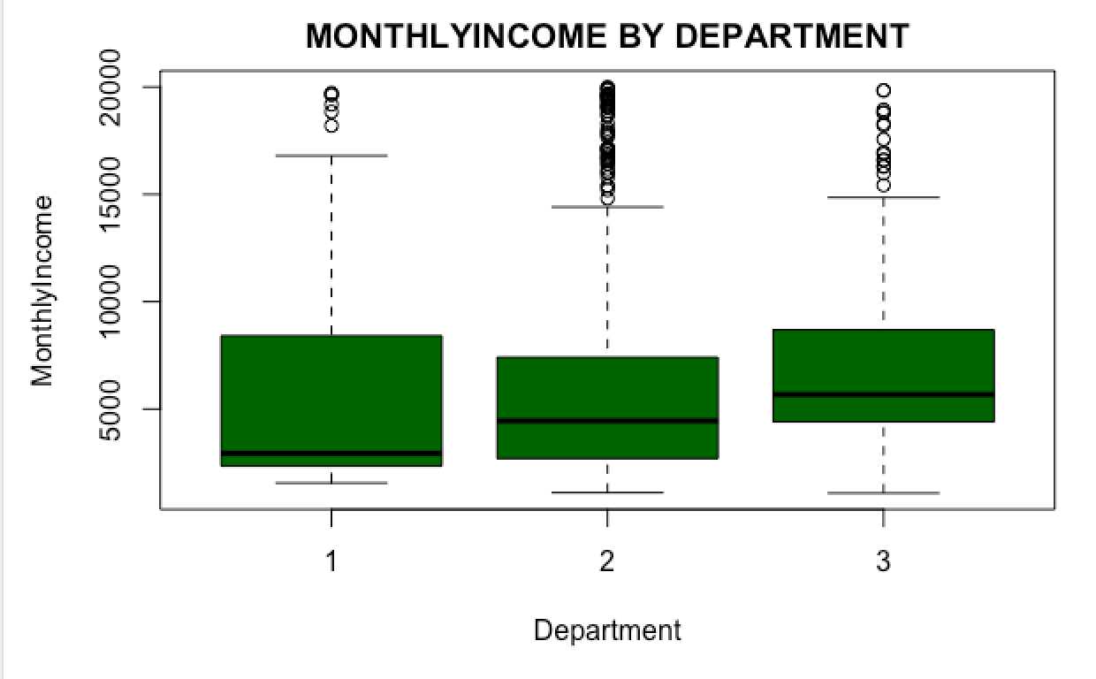
Income Prediction: MLR Assumptions
Constant variance satisfied
Constant variance satisfied
Variables selected : Job Level, Department, Total working years
Assumptions of multiple regression is checked linearity, Constant Variance, normality and independence.
Looking at the box plots we can see that constant variance and linearity seems to be satisfied. Normality is satisfied by large enough sample size

Slide 4
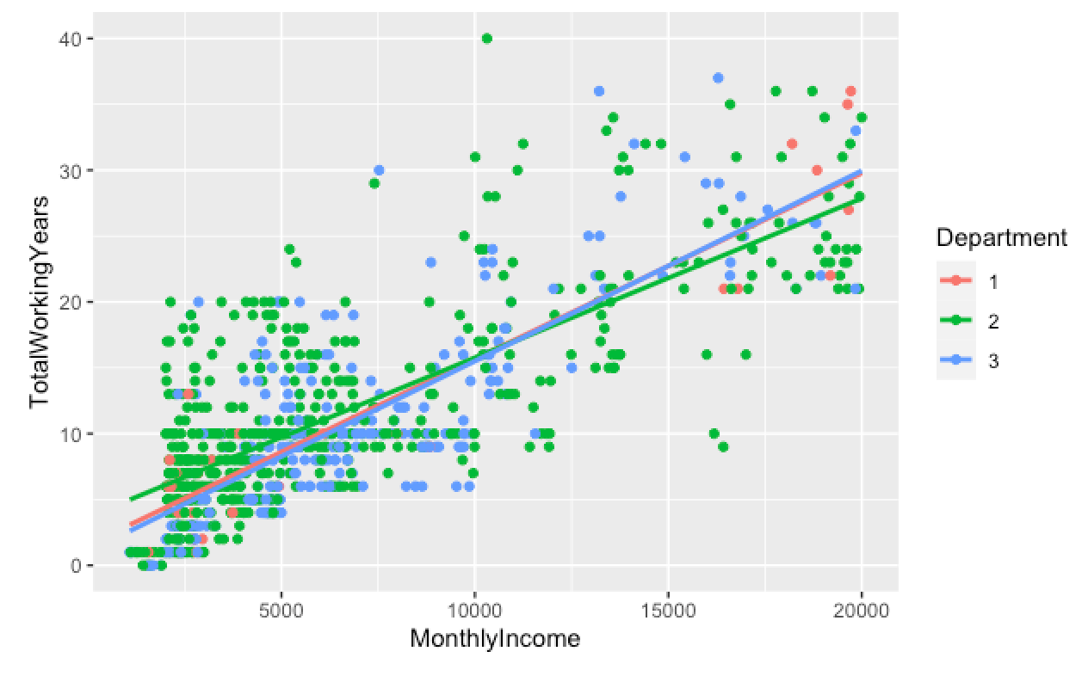
Income Prediction: MLR Assumptions
Evidence of right skew
Evidence of right skew is robust due to large sample size

Slide 5
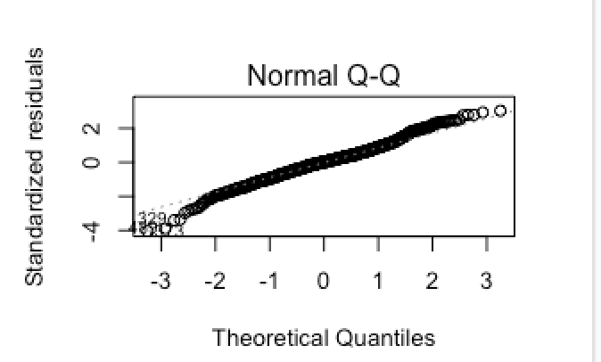
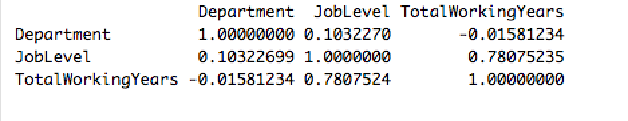
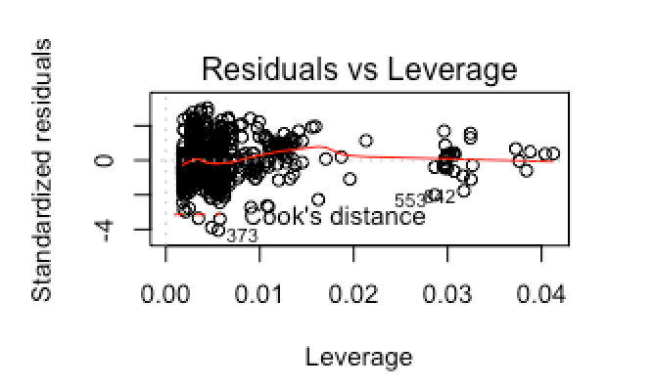
Income Prediction: MLR Assumptions
there seems to be some correlation between total working years and job level however we see that these two variables are still very effective in the model.
The qq plot shows the variables generally come from a normal distribution hence normality is satisfied
The Studentized Leverage diagram shows there
Isn't and extreme values

Slide 6
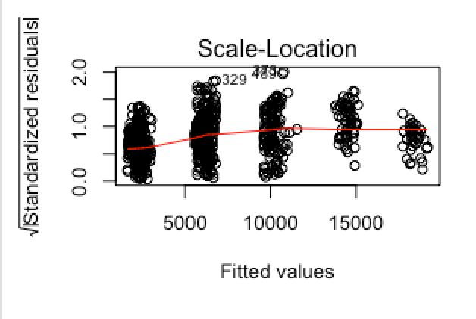
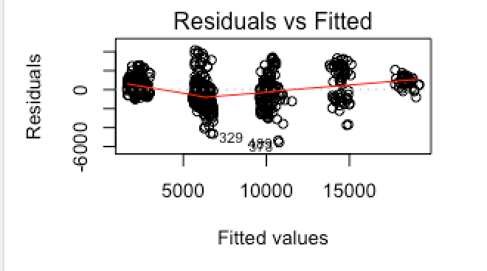
Income Prediction: MLR Assumptions
Residuals seem to be evenly spread out hence the residual analysis is satisfied.
Residuals seem to be evenly spread out hence the residual analysis is satisfied.

Slide 7
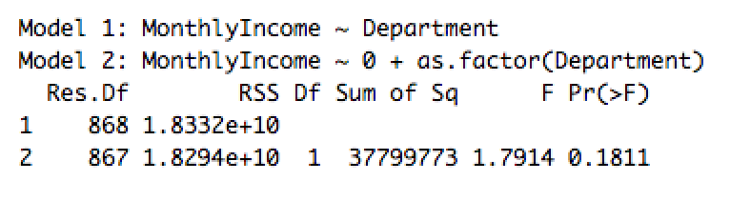
Income Prediction: Lack of fit test
Lack of fit test on department variable to show if Linear regression is as effective as separate means model
Conclusion: Linear regression model is as effective as the separate means model since the p value of 0.18 is above 0.05 alpha level.

Slide 8
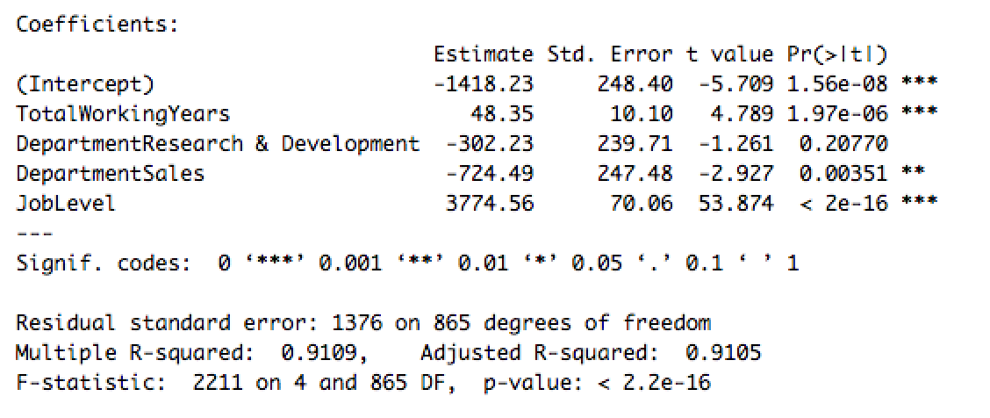
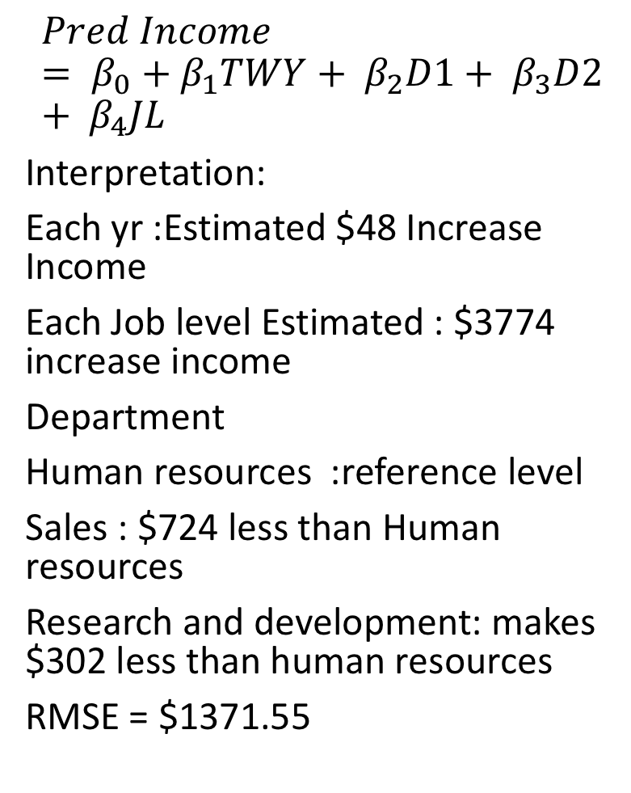
Income Prediction: Results
$$Pred Income= β_{0}+β_{1}TWY+ β_{2}D1+ β_{3}D2+ β_{4}JL$$
Interpretation:
Each yr :Estimated $48 Increase Income
Each Job level Estimated : $3774 increase income
Department
Human resources :reference level
Sales : $724 less than Human resources
Research and development: makes $302 less than human resources
RMSE = $1371.55
Variables selected
Job level : p value 2e-16 (<0.0001)
Total working years: p value 1.97e-06 (<0.0001)
Department
Human resources (reference level)
Sales: p value of 0.0035 < 0.05 significant
Research and development: p value 0.20 not significant

Slide 9
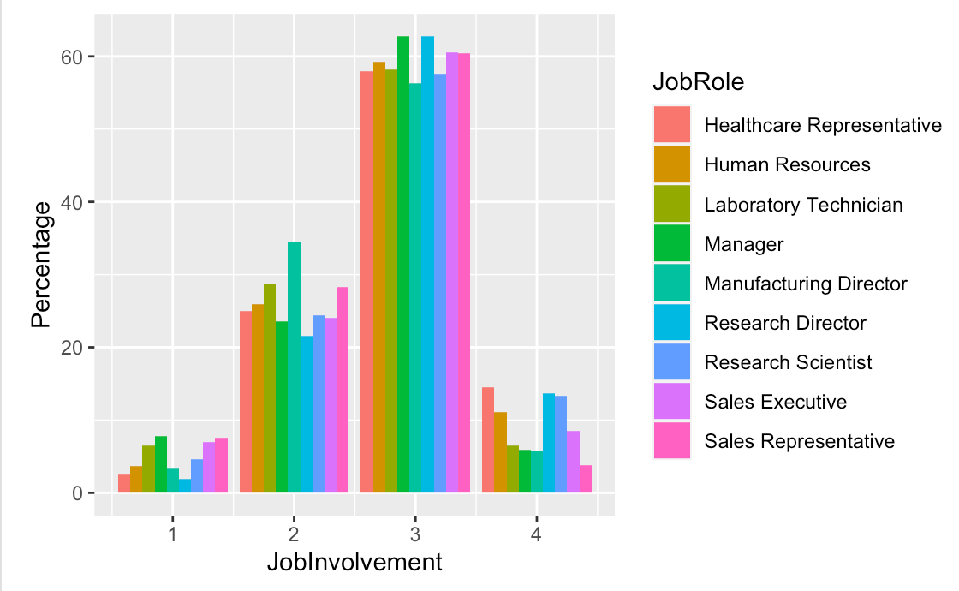
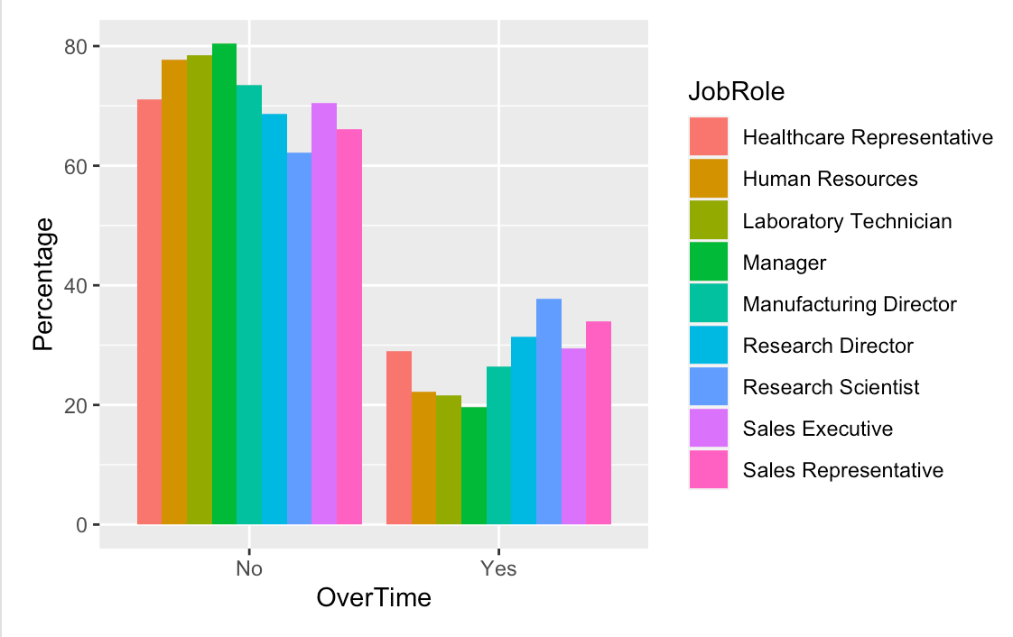
Job Role specific Trends

Slide 10
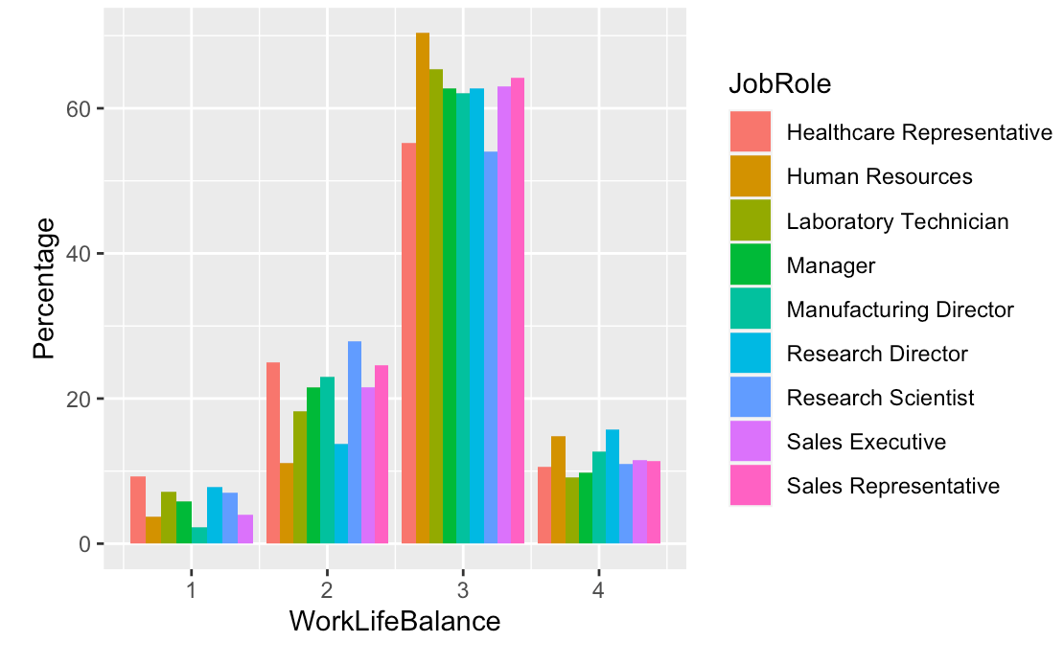
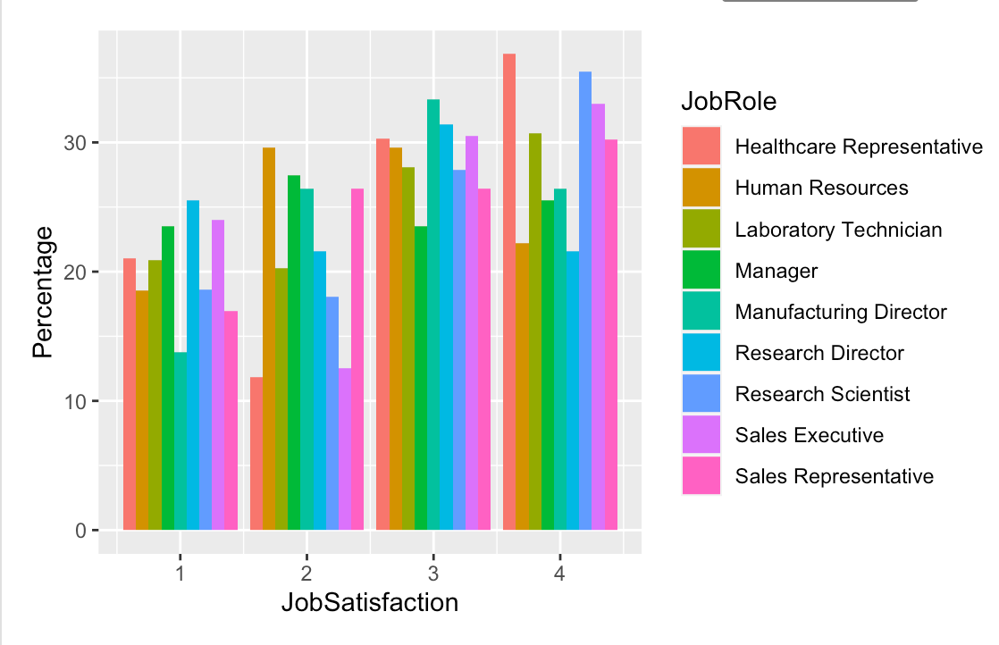
Job Role specific Trends

